Slide 1
Azure App
Services

Slide 2
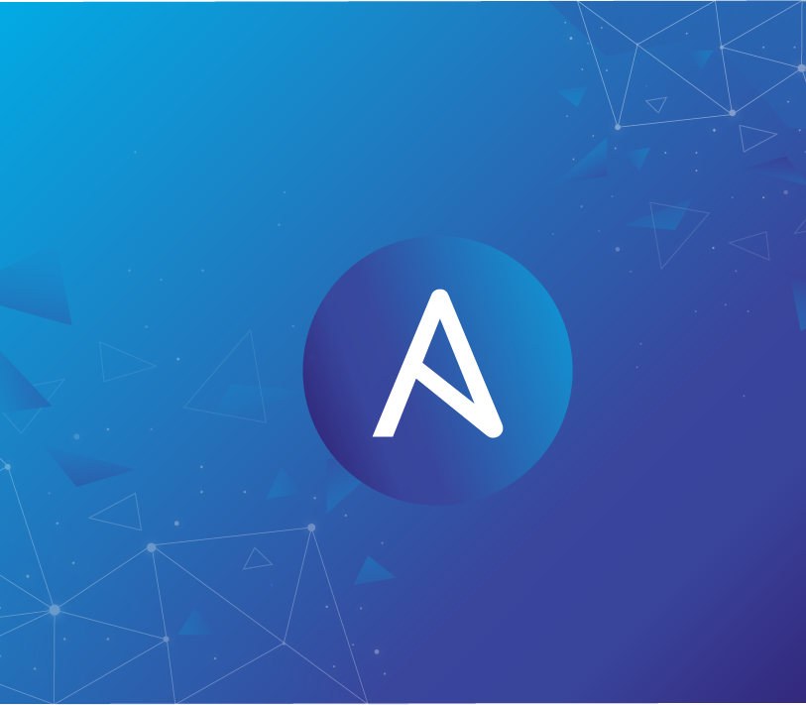


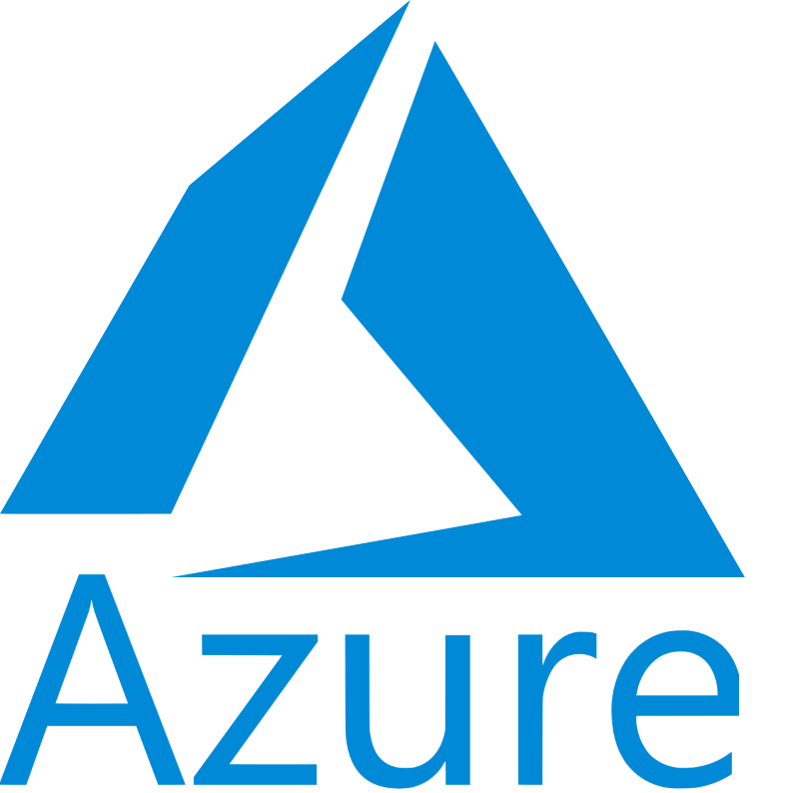
Topics
1.What is App Service?
2.Why use App Service?
3.Types of App Services.
4.Benefits.
5.Azure Service Plan.
6.Limitations.

Slide 3
Azure App Service…
Azure App Service is an HTTP-based service for hosting web applications, REST APIs, and mobile back ends. You can develop in your favourite language, be it .NET, .NET Core, Java, Ruby, Node.js, PHP, or Python. App Service adds the power of Microsoft Azure to your application, such as security, load balancing, autoscaling, and automated management. Additionally, you can take advantage of its DevOps capabilities, such as continuous deployment from Azure DevOps, GitHub, Docker Hub, and other sources, package management, staging environments.

Slide 4
Why Use App Services?
Azure App Service is a fully managed platform as a service (PaaS) offering for developers. Here are some key features of App Service:……..
Multiple languages and frameworks
Managed production environment
Containerization and Docker
DevOps optimization
Global scale with high availability
Connections to SaaS platforms and on-premises data
Security and compliance
Application templates
Visual Studio and Visual Studio Code integration
API and mobile features
Serverless code

Slide 5
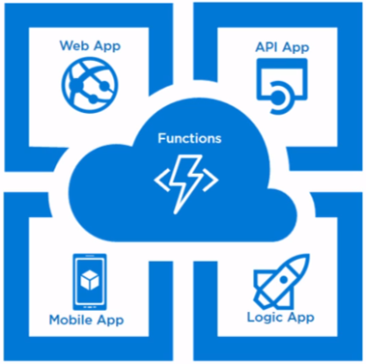
Types of Azure App Services:
1. Web Apps
2. API Apps
3. Logic Apps
4. Mobile Apps
5. Function Apps

Slide 6
Web Apps
It allows us to deploy our web application without having to worry about the necessary infrastructure.
In the traditional deployment method, we must configure the server with the right OS and IIS versions and monitor if the server is up and operating.
The Azure Web App Service removes all of these stumbling blocks.
Here are listed some of the features of the Web app service:
-> Code in .NET, .NET Core, PHP, JAVA, and Python is supported.
-> Support for auto-scaling based on load is built-in.
-> Visual Studio Online, GitHub, and Bit Bucket provide continuous integration and deployment functionality.
-> Virtual networking and hybrid networks are supported.

Slide 7
API Apps
API apps are offering of App Service that helps to host Web APIs.
This enables us to expose existing or new APIs.
This is also a part of the platform as a service and we don’t need to worry about infrastructure plumbing to bring our APIs up and running.
It also supports identity providers to secure the APIs.
The API Apps supports .Net, Java, Python, Node.js to build and deploy Web APIs.
It also comes with an inbuilt swagger implementation which helps in API definition and creating client apps.

Slide 8
Logic Apps
Logic Apps enables us to create functional workflows as a software component.
Logic apps facilitates workflows by using triggers, connectors and actions……

Slide 9
Mobile Apps
Mobile Apps enable us to build a backend for Mobile applications.
It can provide capabilities to mobile client applications.
This can be considered to be the same as a web service to support mobile client scenarios.
The client can be Windows Universal apps, IOS apps, windows apps etc. They use Mobile app SDK to connect with the backend.
There are certain unique capabilities with mobile apps:
→Cross-Platform
→Secured Connections
→Offline Sync
→push Notifications.

Slide 10
Azure Functions
Azure Functions are event-driven components that eliminate the need for a server to host a piece of logical code and process.
An Azure function can run any executable. Azure Functions are also referred to as Server less.
Serverless Azure functions are not fully featured applications but a short-lived task in an application that does a specific job.
Azure functions are supported in multiple languages like C#, F#, Node.js, Python, PHP, batch, bash and any executable file format.

Slide 11
App Service Plans….
1.Free
2.Shared
3.Dedicated
This App Service plan uses a single VM for multiple app service plan and can host multiple applications with some limited computing power.
Shared app service tier, runs in a similar environment as that of a Free tier. This tier allocates CPU quotas to each app that runs on the shared resources, and the resources cannot scale out.
The Dedicated tiers run apps on dedicated Azure VMs.
This tier is further divided into Basic, Standard and Premium with increasing compute power and features.
Basic
Standard
Premium

Slide 12
Limitations:…
Though App Service comes with a lot of benefits and ease of doing cloud-native development and deployments, there are a few limitations which should be understood well.
No Remote Desktop Connection.
No Support for third-party Software management tools.
Performance Counters not visible.

Slide 13
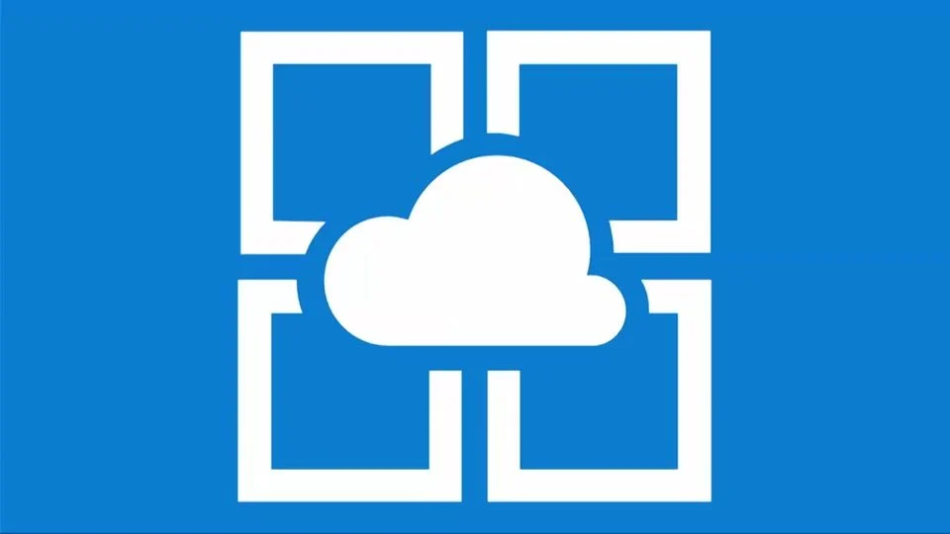
Summary
Azure App Service is a platform as a service offering in Microsoft Azure that enables us to develop web and mobile applications and deploy them in Azure. The unique feature of App Service is its fully managed infrastructure by Azure service fabric that keeps us worry free from any kind of infrastructure plumbing that is required to host the applications such that developers could focus more on delivering business values.

Slide 14
Thank you
KTS Keerthi Reddy

